Slide 2
What is MYSQL?
MySQL is a relational database management system
(RDBMS) developed by Oracle that is based on structured query language (SQL).

Slide 3
What is SQL?
Structured Query Language .
It is a programming language used to interact with relational databases.
It is used to perform CRUD operation.
Create
Read
Update
Delete

Slide 4
What is DATABASE?
A database is an organized collection of
structured information, or data

Slide 5
What is DBMS?
Database Management System (DBMS) a Software
system that is used to manage our
database(DB) is called DBMS

Slide 6
Types Of DBMS?
DBMS
Relational (SQL)
Non-Relationl (no-SQL)

Slide 7
Relational Database?
Data stored in tables
We use SQL to work with relational database
Example : MySQL , Oracle , SQL Server , MariaDB , MSSQL

Slide 8
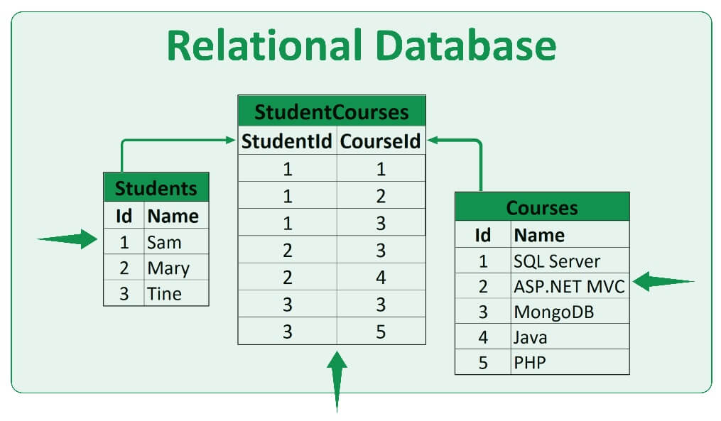

Slide 9
Non-Relational Database?
Data not stored in tables
We use SQL to work with relational database
Example : mongo DB

Slide 10
SQL Commands
SQL commands are instructions used to communicate with the database
There are two types of commands
Data Definition Language
Data manipulation Language

Slide 11
Types Of DDL Commands
Data Definition Language
Create
Alter
Drop
Truncate
Comment
Rename

Slide 12
Types Of DML Commands
Data Manipulation Language
Insert
Update
Select
Delete
Merge

Slide 13
Different Types of Data types in MySQL
1. Numeric Data Types
Used to store numbers (integers and decimals).
INT / INTEGER , DECIMAL(M,D)
DECIMAL is used for exact numbers, like money (e.g., 99.99), where accuracy is important.
2. String (Character) Data Types
Used to store text/character strings.
VARCHAR(n)

Slide 14
Different Types of Data types in MySQL
3. Date and Time Data Types
Used to store date, time, or both.
TIMESTAMP , DATE ,

Slide 15
Example:
CREATE TABLE users (
id INT AUTO_INCREMENT PRIMARY KEY,
name VARCHAR(100),
email VARCHAR(255),
birthdate DATE,
balance DECIMAL(10,2), →12334334.56
created_at TIMESTAMP DEFAULT CURRENT_TIMESTAMP
);

Slide 16
Creating Our first Database
Our first SQL Query
CREATE DATABASE db-name;
DROP DAYABASE db-name;
USE db-name;

Slide 17
Creating Table Syntax
USE db-name;
CREATE TABLE table_name (
column1_name datatype constraints,
column2_name datatype constraints,
...
columnN_name datatype constraints
);
CREATE TABLE employees (
id INT PRIMARY KEY,
name VARCHAR(100),
age INT NOT NULL,
department VARCHAR(100),
salary DECIMAL(10, 2)
);

Slide 18
Insert Values In Table
INSERT INTO table_name (column1, column2, column3…..column)
VALUES
(value1, value2, value3…..valueN);

Slide 19
Update Values In Table
UPDATE table_name
SET column1 = value1 , column2 = value2
WHERE id = value;

Slide 20
Delete Values In Table
The DELETE command is used to delete existing records in a table.
Syntax:
DELETE FROM table_name WHERE condition;
EX:
DELETE FROM student WHERE id = 2;

Slide 21
Alter Table:
The ALTER TABLE statement is used to add, delete, or modify columns in
An existing table.
ADD column syntax:
ALTER TABLE table_name
ADD COLUMN column name;

Slide 22
Alter Table:
The ALTER TABLE statement is used to add, delete, or modify columns in
An existing table.
DROP column syntax:
ALTER TABLE table_name
DROP COLUMN column name;

Slide 23
Alter Table:
The ALTER TABLE statement is used to add, delete, or modify columns in
An existing table.
MODIFY column syntax:
ALTER TABLE table_name
ALTER COLUMN column_name datatype;
MODIFY – It only changes the data type or constraints (like NOT NULL, DEFAULT, etc.) of an existing column.
It does not change the column name.

Slide 24
Foreign Key:
It is an attribute that references to primary key of same table or another table(relation)
Syntax:
CREATE TABLE ChildTable (
column_name datatype,
...
FOREIGN KEY (column_name) REFERENCES ParentTable(primary_key_column)
);

Slide 25
Purpose of Foreign Key :
Avoid Data Duplication:
Student data is stored only once in the student table.
Easy Updates:
Update student details in one place; all related data stays consistent.
Maintain Relationships:
Foreign keys connect related tables like student and course.
Ensure Data Integrity:
Prevents inserting course records for non-existent students.

Slide 26
Create table Without foreign key:
INSERT INTO student_course VALUES
(1, 'Ali', 20, 101, 'Math'),
(1, 'Ali', 20, 102, 'Physics'),
(1, 'Ali', 20, 103, 'Biology');
This approach create tha data duplication

Slide 27
Show Student name with each course
SELECT s.name, c.Course_name
FROM student s
JOIN course c ON s.Roll_num = c.Roll_num;

Slide 28
Foreign Key:
Parent table student:
CREATE TABLE student (
Roll_num INT PRIMARY KEY,
name VARCHAR(20),
age INT
);

Slide 29
Foreign Key:
Child Table (course) — foreign key referencing student:
CREATE TABLE course (
CourseID INT PRIMARY KEY,
Course_name VARCHAR(30),
Roll_num INT,
FOREIGN KEY (Roll_num) REFERENCES student(Roll_num)
);

Slide 30
SQL Operator
SQL operators help us filter, compare, and calculate values in a database easily.
LIKE
IN
BETWEEN
DISTINCT

Slide 31
1. LIKE Operator
Used to search for a specific pattern in a text column.
Syntax:
SELECT * FROM table_name
WHERE column_name LIKE 'pattern';
Examples:
-- Names starting with 'A'
SELECT * FROM students
WHERE name LIKE 'A%';

Slide 32
1. LIKE Operator
-- Names ending with 'n'
SELECT * FROM students
WHERE name LIKE '%n';
-- Names with 'li' in the middle
SELECT * FROM students
WHERE name LIKE '%li%';

Slide 33
2. IN Operator
Used to match a column value with multiple values at once (like OR).
Syntax:
SELECT * FROM table_name
WHERE column_name IN (value1, value2, ...);

Slide 34
2. IN Operator
Examples:
-- Students from specific cities
SELECT * FROM students
WHERE city IN ('Lahore', 'Karachi', 'Islamabad');
-- Students with roll numbers 1, 3, or 5
SELECT * FROM students
WHERE roll_no IN (1, 3, 5);

Slide 35
3. BETWEEN Operator
Used to filter data within a range of values (numbers, text, or dates).
Syntax:
SELECT * FROM table_name
WHERE column_name BETWEEN value1 AND value2;

Slide 36
3. BETWEEN Operator
Examples:
-- Marks between 60 and 80
SELECT * FROM students
WHERE marks BETWEEN 60 AND 80;
-- Dates between Jan 1 and Dec 31
SELECT * FROM orders
WHERE order_date BETWEEN '2024-01-01' AND '2024-12-31';

Slide 37
4. DISTINCT Operator
It allows us to retrieve unique records of table)
Syntax:
SELECT DISTINCT column_name
FROM table_name;

Slide 38
SQL JOIN
JOIN means to combine something.
A JOIN clause is used to combine data from two or more
tables, based on a related column between them

Slide 39
Types of SQL Joins:
INNER JOIN
LEFT JOIN (or LEFT OUTER JOIN)
RIGHT JOIN (or RIGHT OUTER JOIN)
FULL JOIN (or FULL OUTER JOIN)

Slide 40
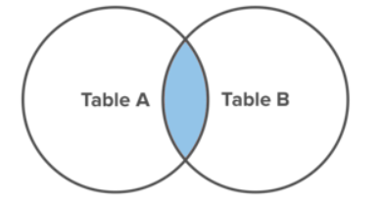
INNER JOIN
Returns records that have matching values in both table.

Slide 41
INNER JOIN
Syntax:
SELECT column_name(s)
FROM TableA
INNER JOIN TableB
ON TableA.col_name = TableB.col_name

Slide 42
INNER JOIN
Example
SELECT *
FROM student AS s
INNER JOIN course AS c
ON s.Roll_num = c.Roll_num;

Slide 43
Student table
INSERT INTO student (Roll_num, name, age) VALUES
(1, 'Ali', 20),
(2, 'Sara', 22),
(3, 'Rehman', 21);

Slide 44
Course table
INSERT INTO course (CourseID, Course_name, Roll_num) VALUES
(101, 'Math', 1),
(102, 'Physics', 1),
(103, 'Biology', 3);

Slide 45
Explain Subqueries and Their Usage
A subquery is a query nested inside another SQL query. It is used to perform intermediate results and pass them to the main (outer) query.
Usage:
Filtering rows
Calculations
Comparisons

Slide 46
Explain Subqueries and Their Usage
Syntax:
SELECT column1, column2, ...
FROM table_name
WHERE column_name operator (SELECT column_name FROM table_name WHERE condition);

Slide 47
Create Table Query
CREATE TABLE students (
id INT PRIMARY KEY,
name VARCHAR(50),
marks INT,
class VARCHAR(10)
);

Slide 48
Create Table Query
INSERT INTO students (id, name, marks, class) VALUES
(1, 'Ali', 75, '10A'),
(2, 'Sara', 88, '10A'),
(3, 'Ahmed', 65, '10A'),
(4, 'Zainab', 92, '10A'),
(5, 'Usman', 55, '10A');
Average marks = (75 + 88 + 65 + 92 + 55) / 5 = 75

Slide 49
Create Table Query
SELECT name
FROM students
WHERE marks > (SELECT AVG(marks) FROM students);

Slide 50
Outline the Clauses and Keywords Used in Subqueries
Common clauses and keywords in subqueries include:
WHERE
FROM
SELECT
IN, NOT IN, EXISTS, NOT EXISTS
=, <, >, <=, >=, <>

Slide 51
Clause FROM: Create departments table
CREATE TABLE departments (
dept_id INT PRIMARY KEY,
dept_name VARCHAR(50)
);

Slide 52
Clause FROM: Create departments table
INSERT INTO departments (dept_id, dept_name) VALUES
(1, 'HR'),
(2, 'Finance'),
(3, 'IT'),
(4, 'Marketing');

Slide 53
Create employees Table
CREATE TABLE employees (
emp_id INT PRIMARY KEY,
name VARCHAR(50),
dept_id INT,
FOREIGN KEY (dept_id) REFERENCES departments(dept_id)
);

Slide 54
Create employees Table
INSERT INTO employees (emp_id, name, dept_id) VALUES
(101, 'Ali', 1),
(102, 'Sara', 2),
(103, 'Ahmed', 1),
(104, 'Zainab', 3),
(105, 'Usman', 4);

Slide 55
Using the FROM Clause in Subqueries
SELECT name
FROM employees
WHERE dept_id = (SELECT dept_id FROM departments WHERE dept_name = 'HR');

Slide 56
Define IN, NOT IN, EXISTS, and NOT EXISTS Keywords
IN
SELECT name
FROM students
WHERE id IN (SELECT student_id FROM enrollments WHERE course = 'Math');

Slide 57
Define IN, NOT IN, EXISTS, and NOT EXISTS Keywords
NOT IN
SELECT name
FROM students
WHERE id NOT IN (SELECT student_id FROM enrollments WHERE course = 'Math');

Slide 58
Define IN, NOT IN, EXISTS, and NOT EXISTS Keywords
Returns TRUE if the subquery returns any row
EXISTS
SELECT name
FROM students s
WHERE EXISTS (
SELECT 1 FROM enrollments e WHERE e.student_id = s.id AND e.course = 'Math'
);

Slide 59
Define IN, NOT IN, EXISTS, and NOT EXISTS Keywords
Returns TRUE if the subquery returns no rows.
NOT EXISTS
SELECT name
FROM students s
WHERE NOT EXISTS (
SELECT 1 FROM enrollments e WHERE e.student_id = s.id AND e.course = 'Math'
);

Slide 60
SQL FUNCTIONS
Built-In Functions Pre-defined functions provided by the database management system (DBMS).
User Defined Functions Functions created by users or developers to extend the functionality of SQL

Slide 61
Built-In Functions
Aggregate Functions
String Functions
Numeric Functions
Date and Time Functions
Conversion Functions

Slide 62
Aggregate Function
Aggregate functions in SQL are used to perform calculations on sets of rows and return a single value as a result.
COUNT()
SUM()
AVG()
MIN()
MAX()

Slide 63
ORDER BY Clause in SQL
The ORDER BY keyword is used to sort the result-set in ascending or descending order.
The ORDER BY keyword sorts the records in ascending order by default.
To sort the records in descending order, use the DESC keyword.

Slide 64
ORDER BY Clause in SQL
SYNTAX:
SELECT column1, column2, ...
FROM table_name
ORDER BY column_name [ASC | DESC];

